Slide 1

PROJECT 4A:
A NOOK TO INSPIRE

Slide 2
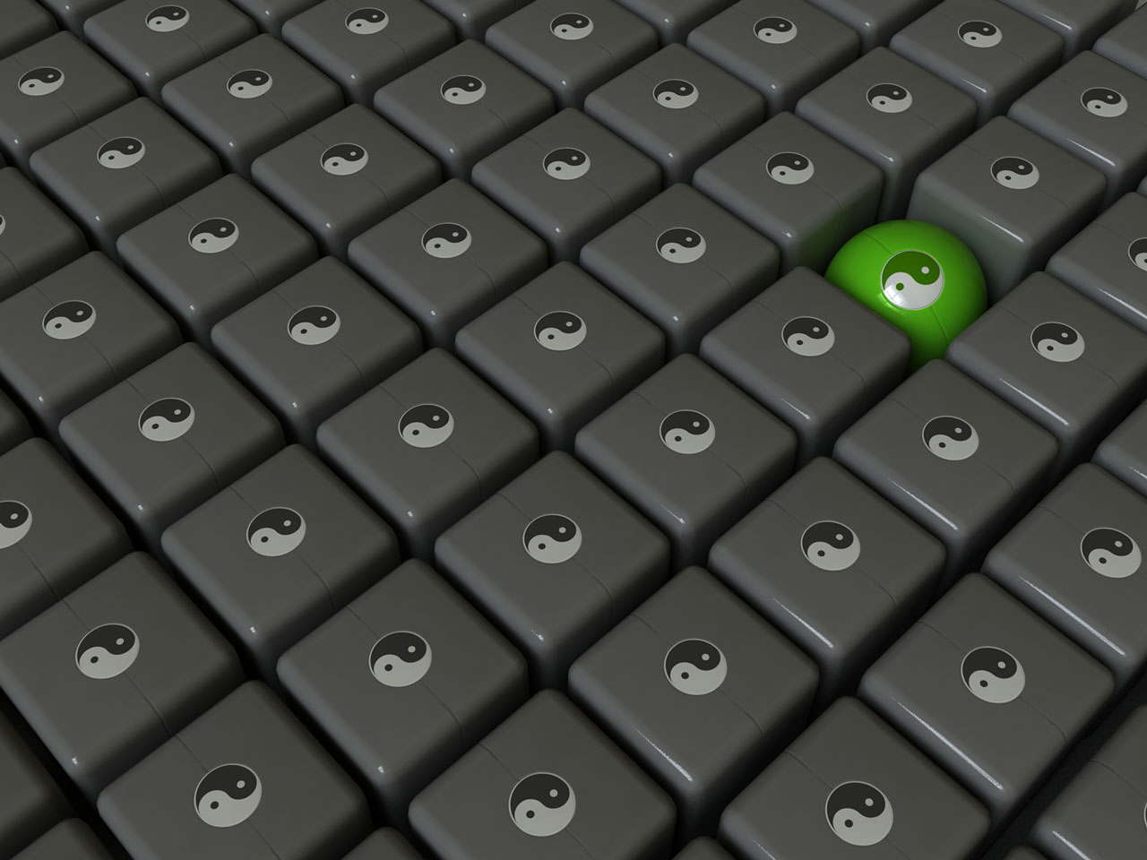
NAME: KHOR SHUIN CHENG
MATRIC NO: 103680
COURSE: QUANTITY SURVEYING issue date: 10/8/2009 due date: 14/8/2009

Slide 3
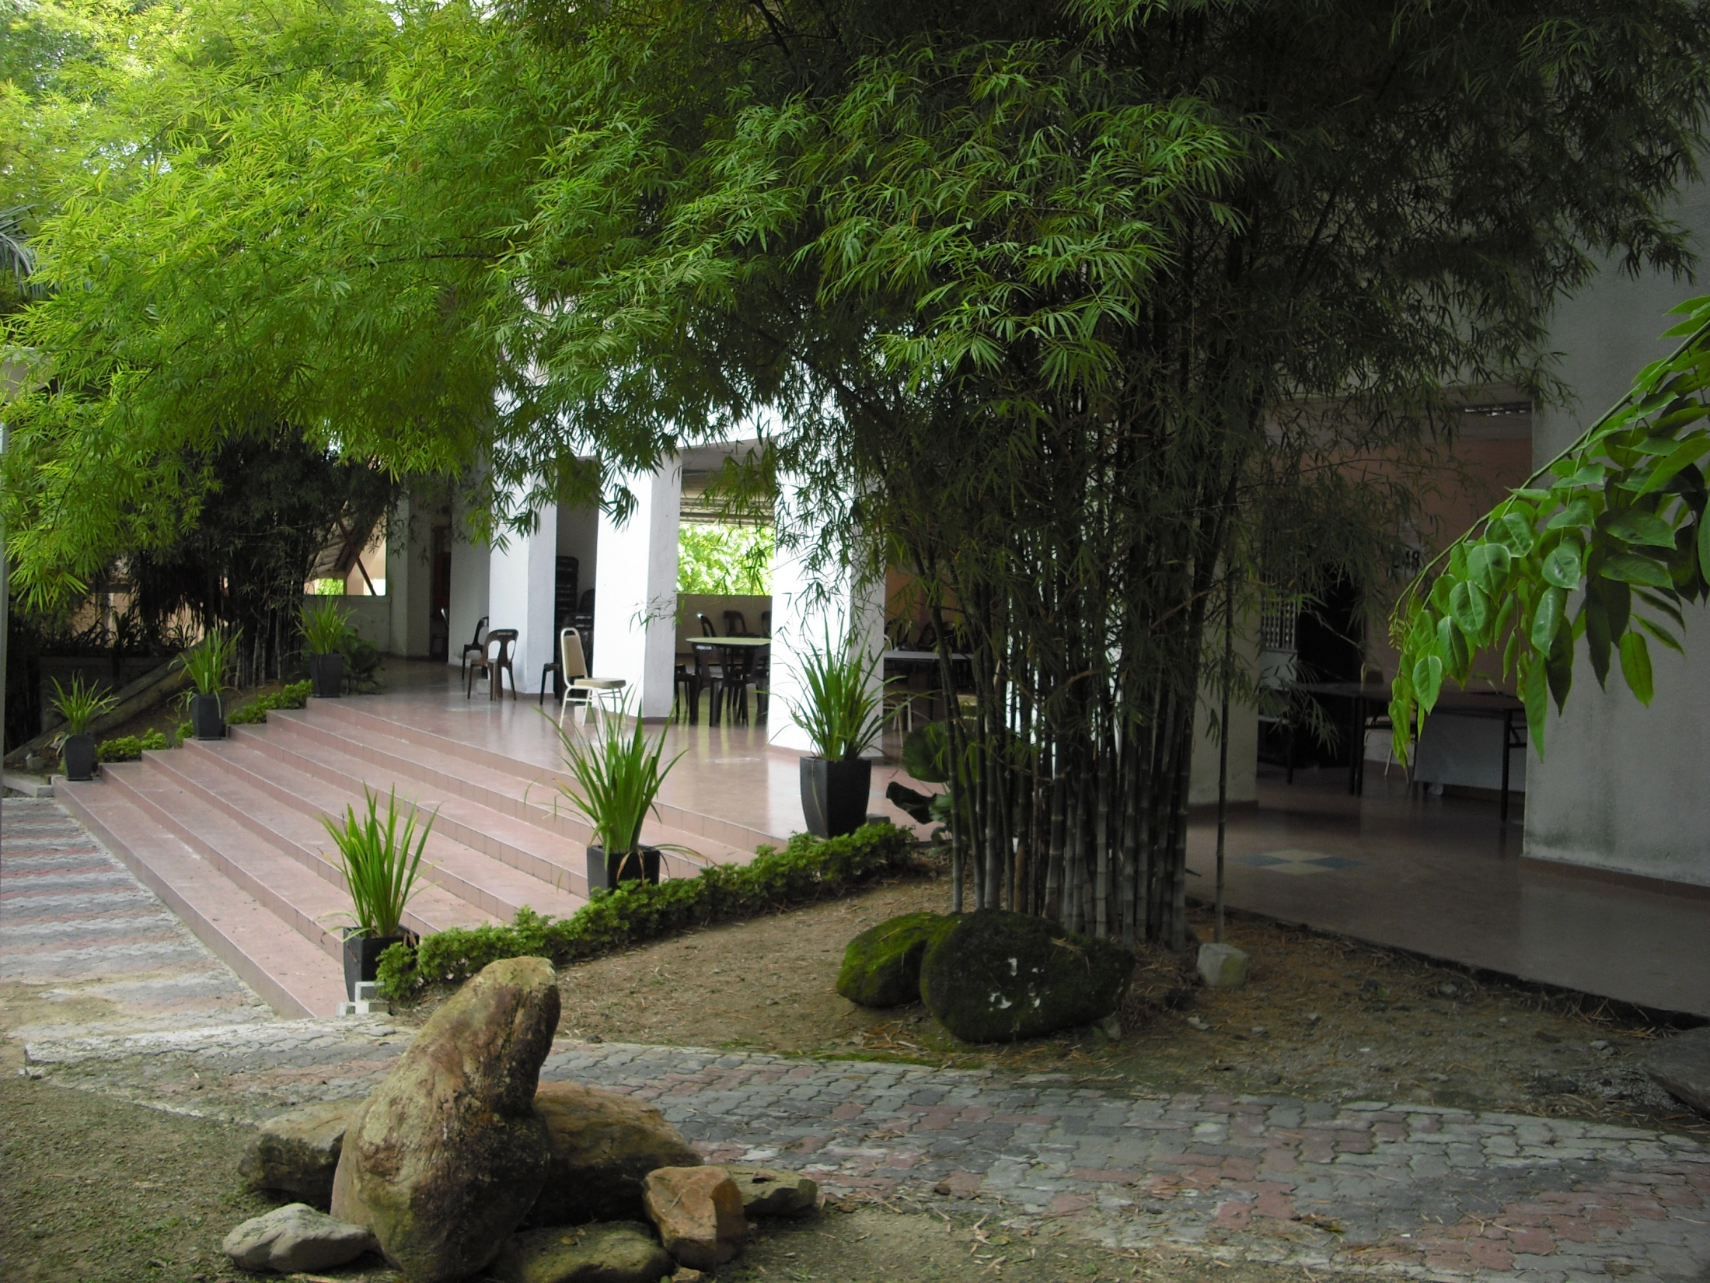
My Site: In front of E48B

Slide 4
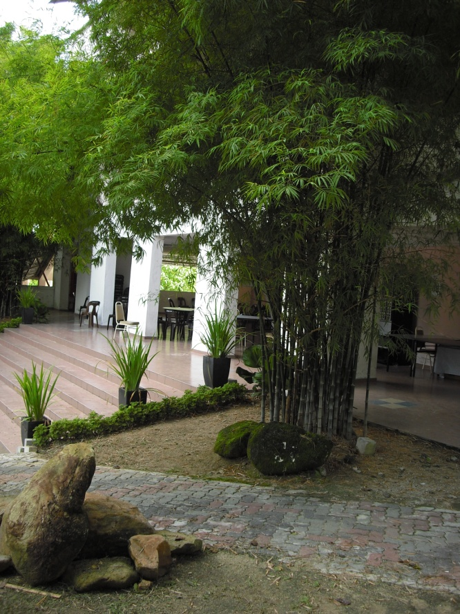
Why I Chose The Site?
WHY THE SITE IS CHOSEN?
THE SITE IS AT THE CENTRE OF SCHOOL OF HOUSING,
BUILDING AND PLANING (HBP), IN FRONT OF E48B,
NEAR THE BUS STATION.
THE SPACE LOOKS BEAUTIFUL,
A LOT OF BAMBOOS AROUND THERE,
A GOOD PLACE TO RELAX IF NOBODY WAS THERE.
PEOPLE WILL PASS BY THERE
EXPECIALLY MORNING AND AFTERNOON SESSION.

Slide 5
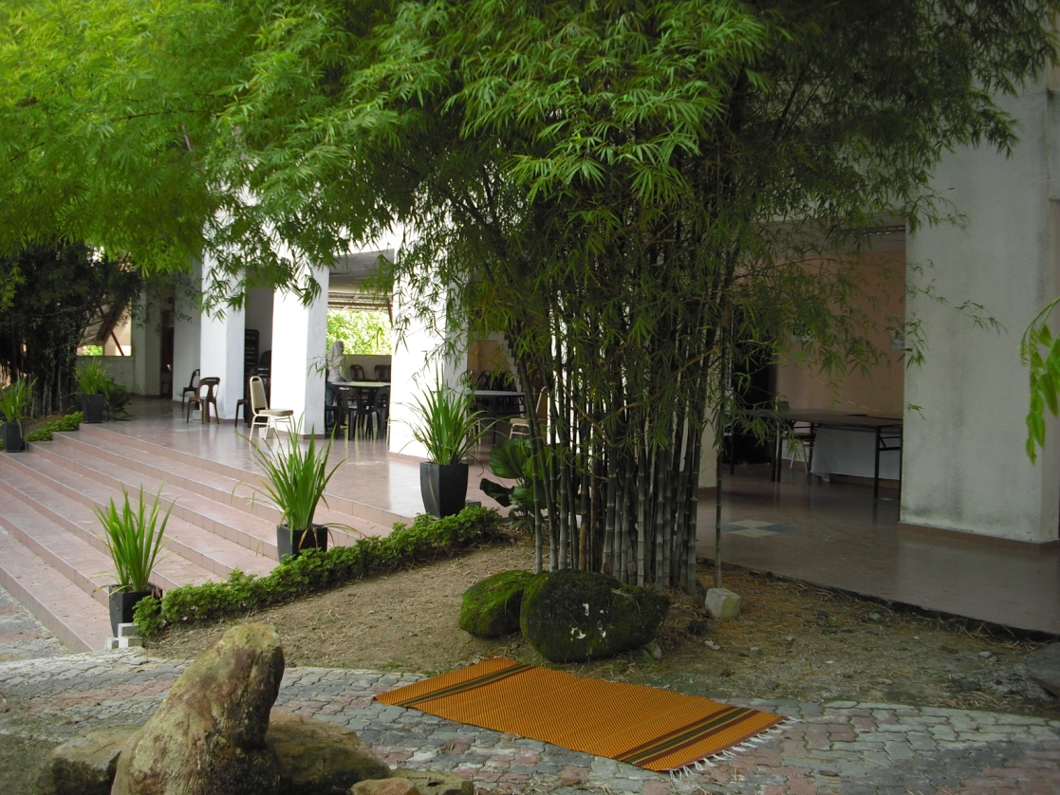
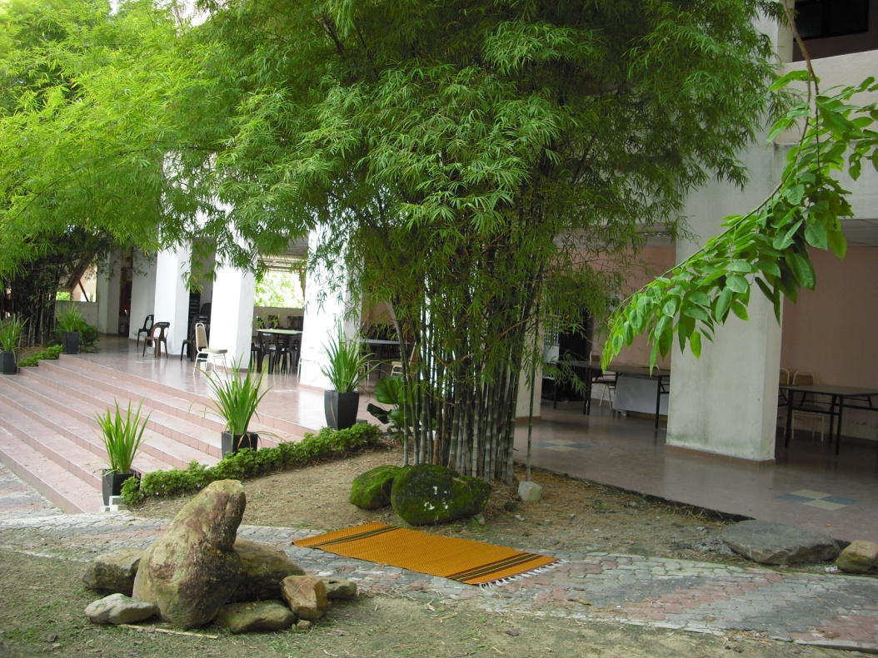
MY ‘TIKAR’
MY SPACE – IN FRONT OF E48B

Slide 6
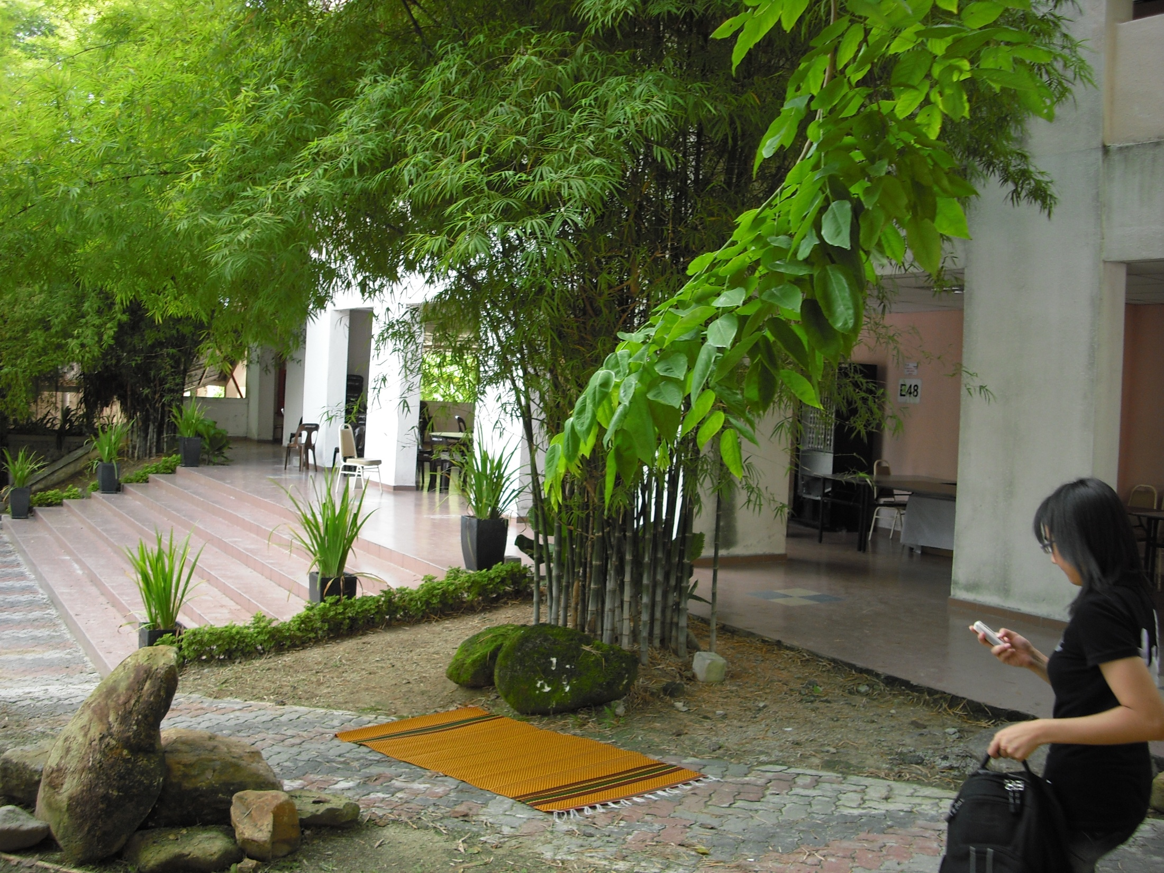


Slide 7
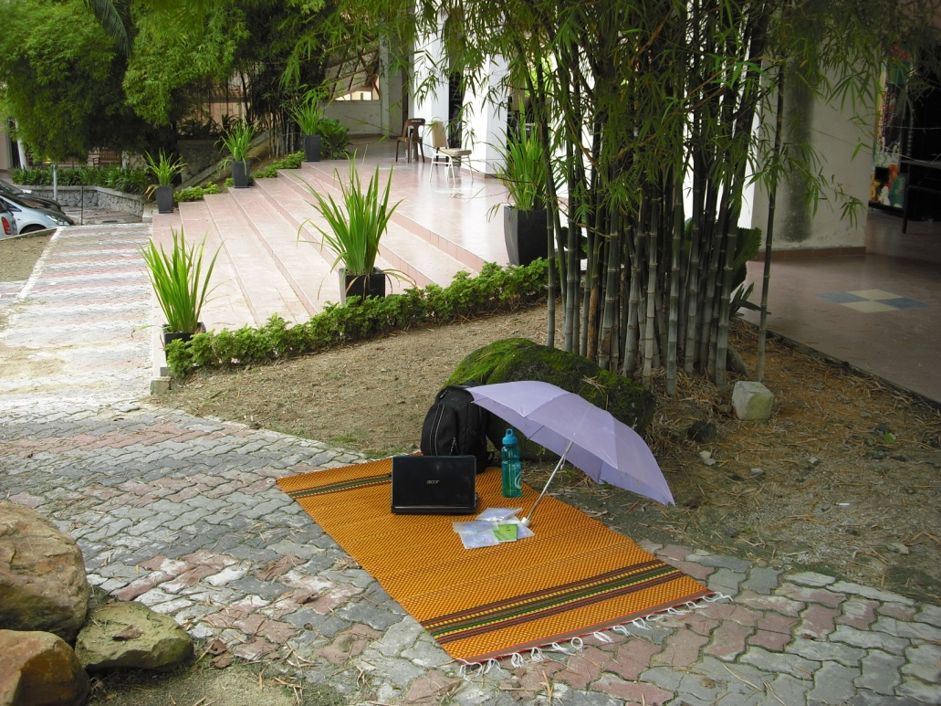
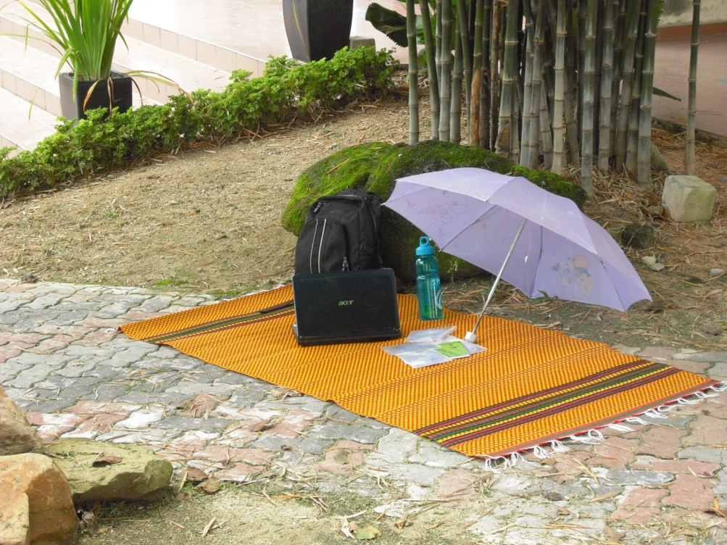
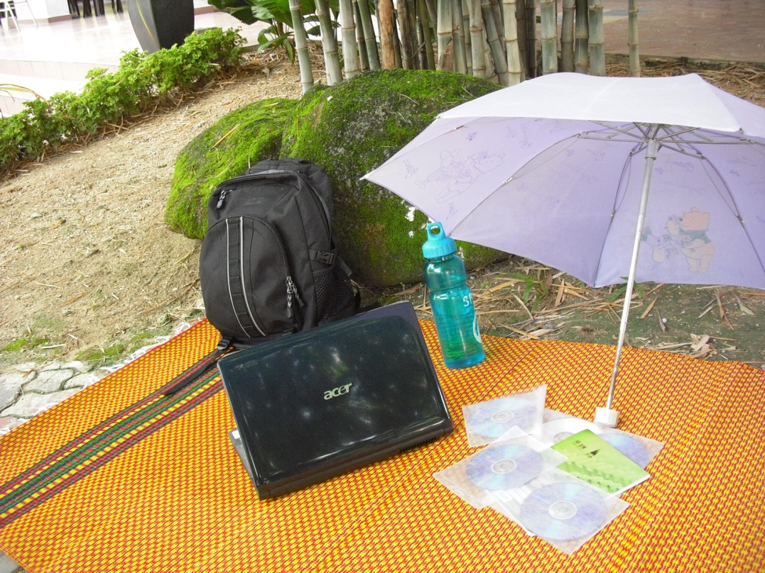
THESE ARE
MY PERSONAL BELONGINGS…
UMBRELLA, BAG, BOTTLE,
LAPTOP, COMPACT DISC,
NOTES

Slide 8
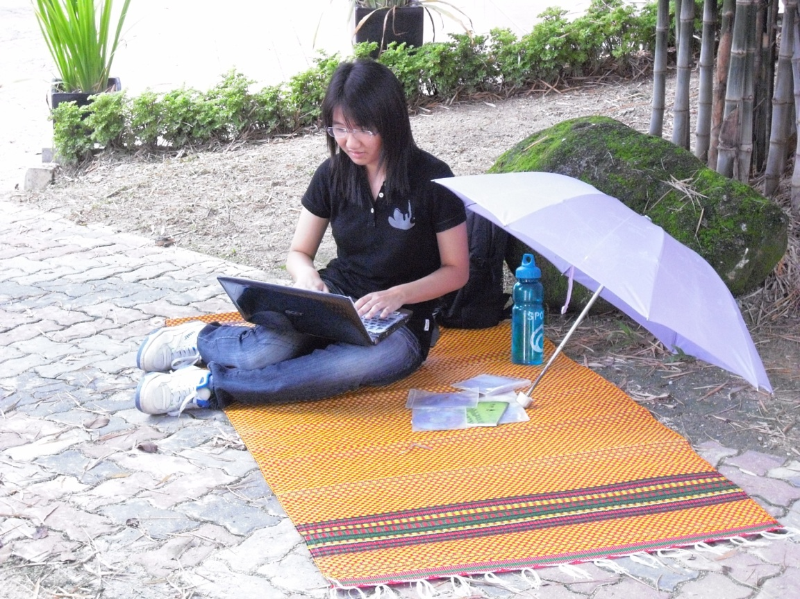
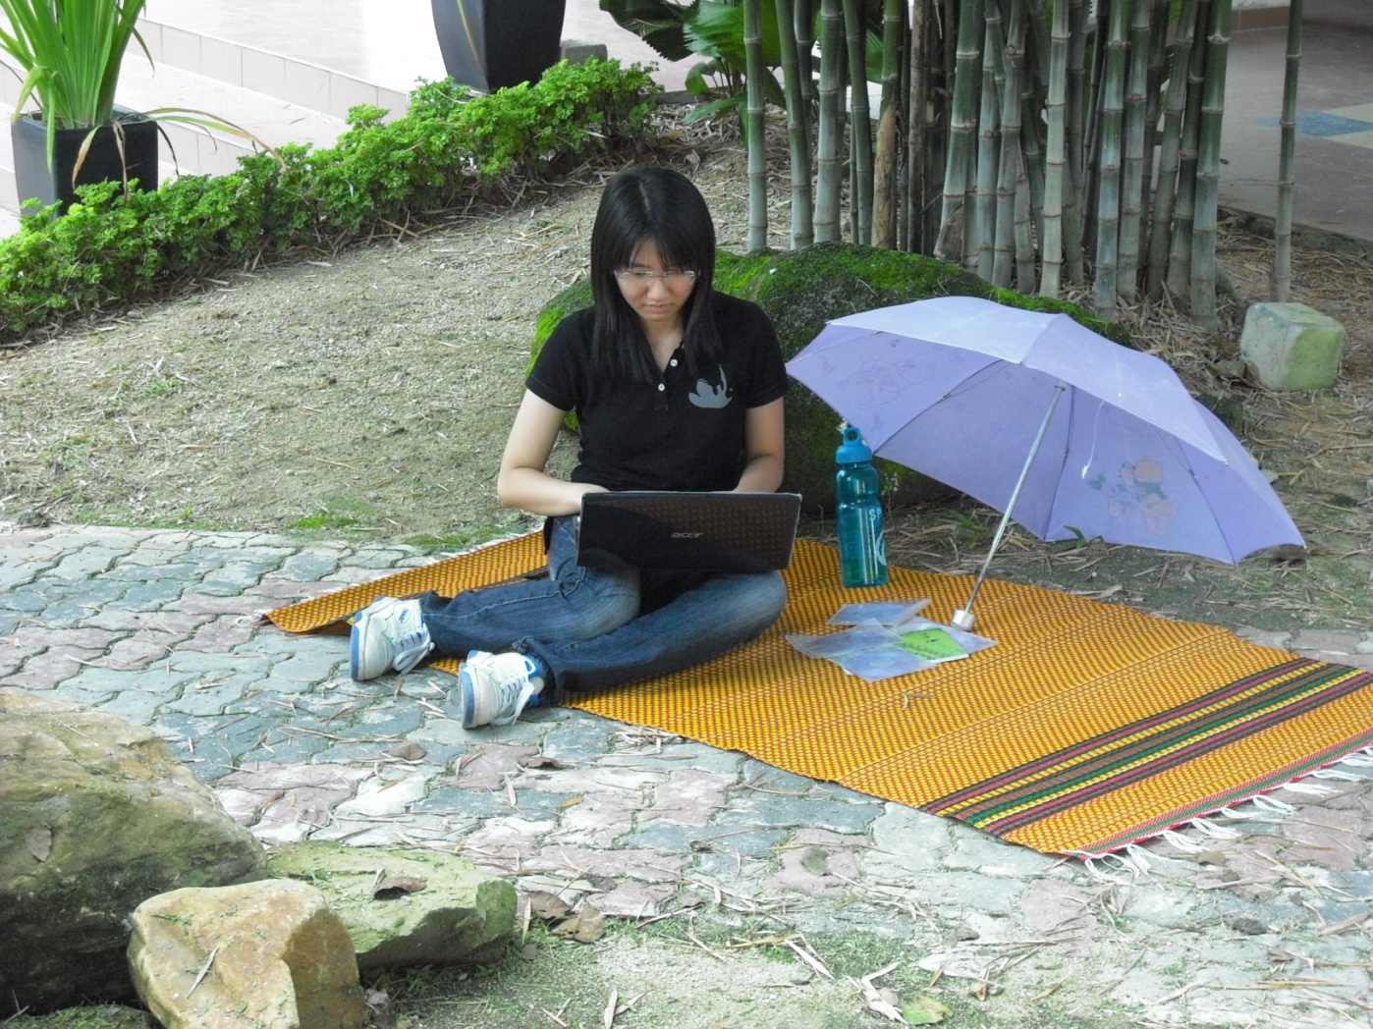
WHAT AM I DOING AT MY SPACE ?
TO SIT ON MY ‘TIKAR’

Slide 9
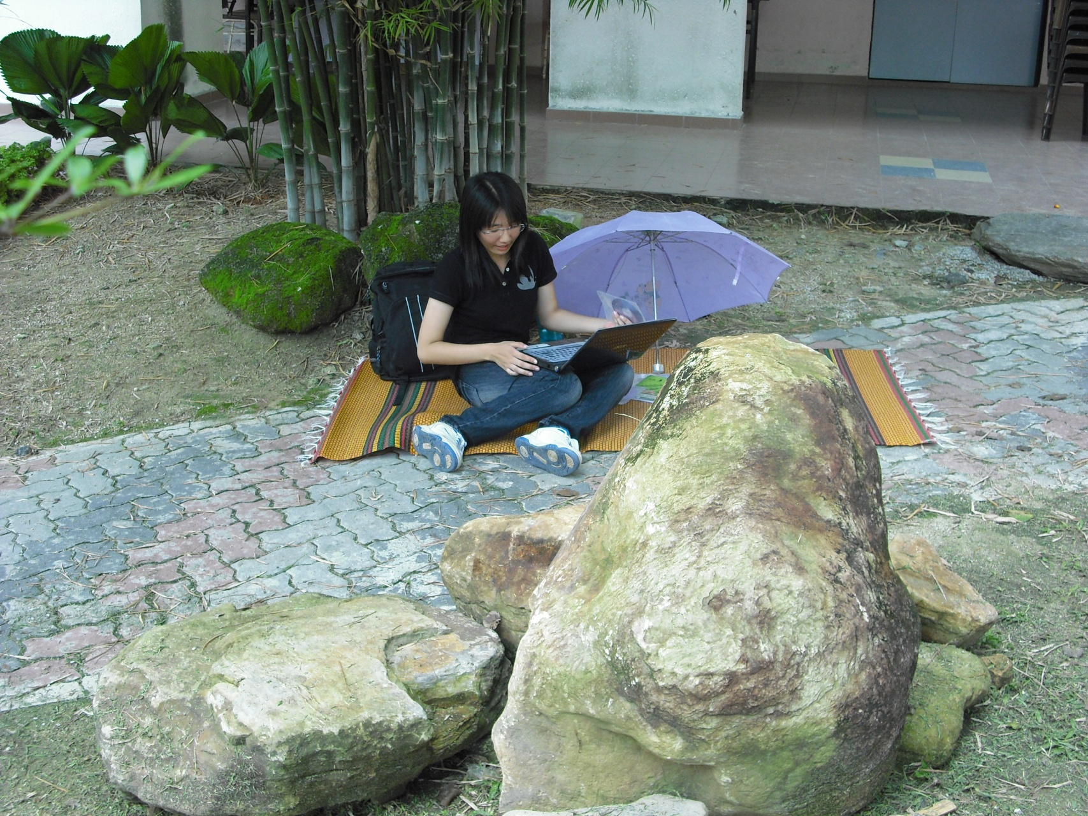
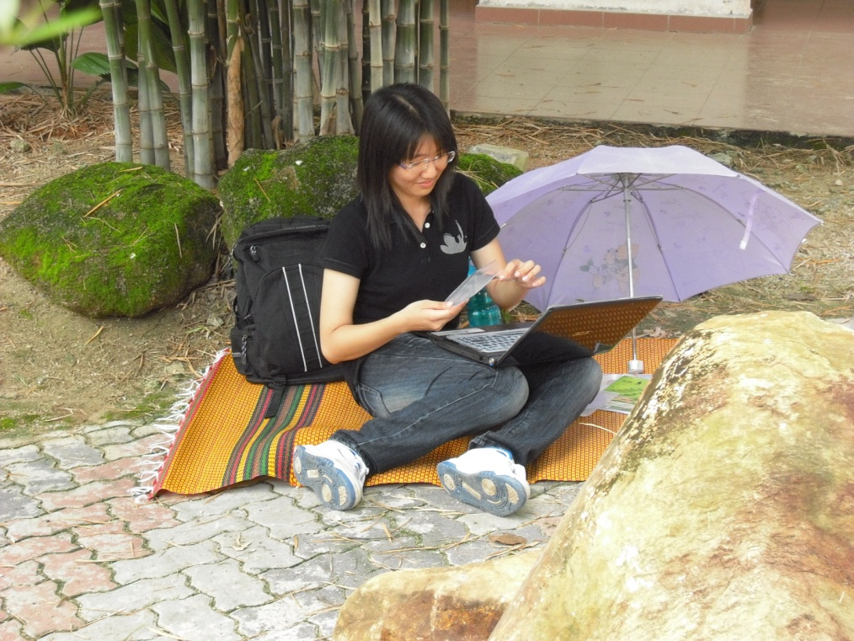
WHAT AM I DOING AT MY SPACE ?
TO SIT ON MY ‘TIKAR’

Slide 10
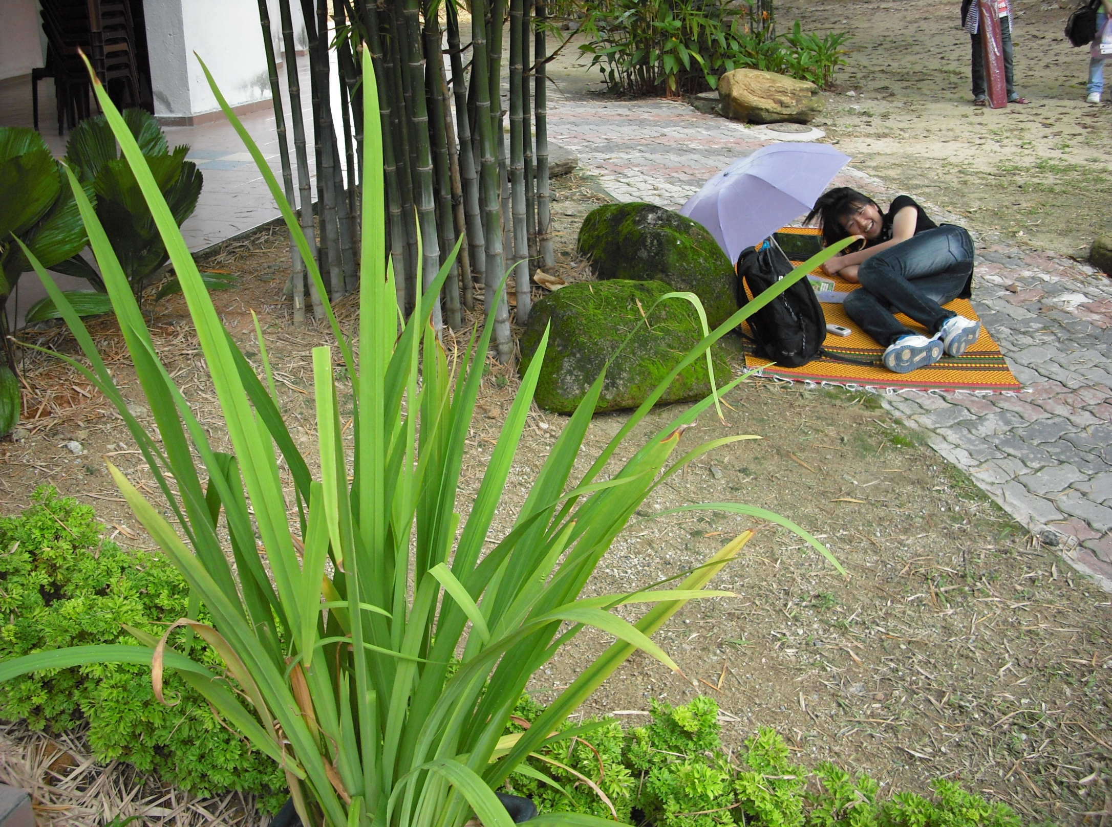
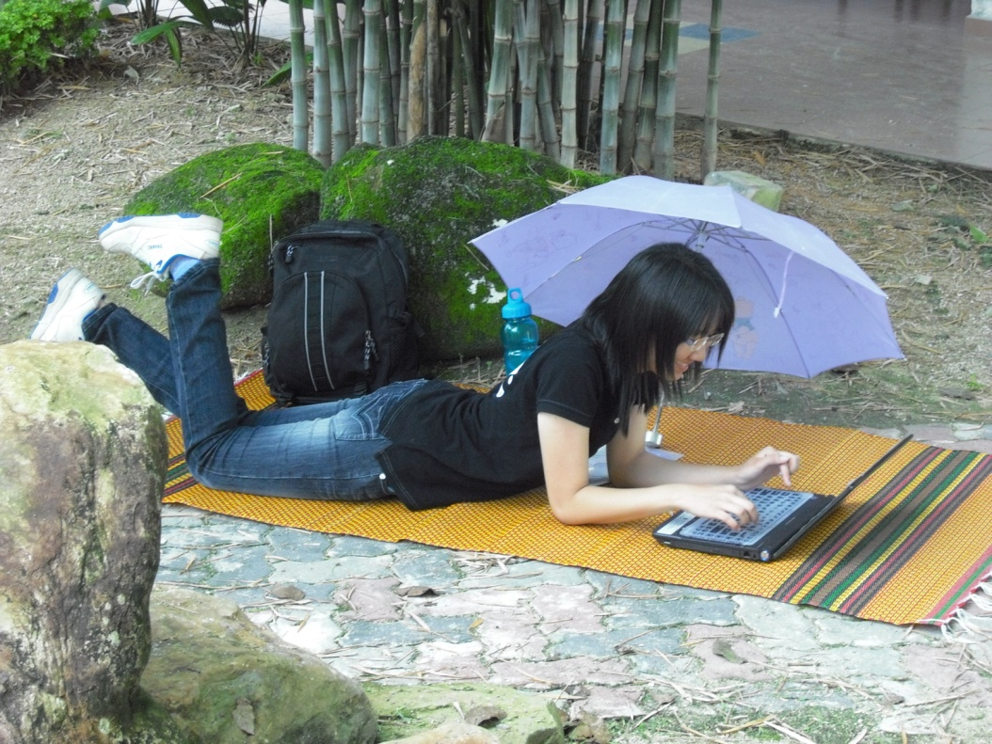
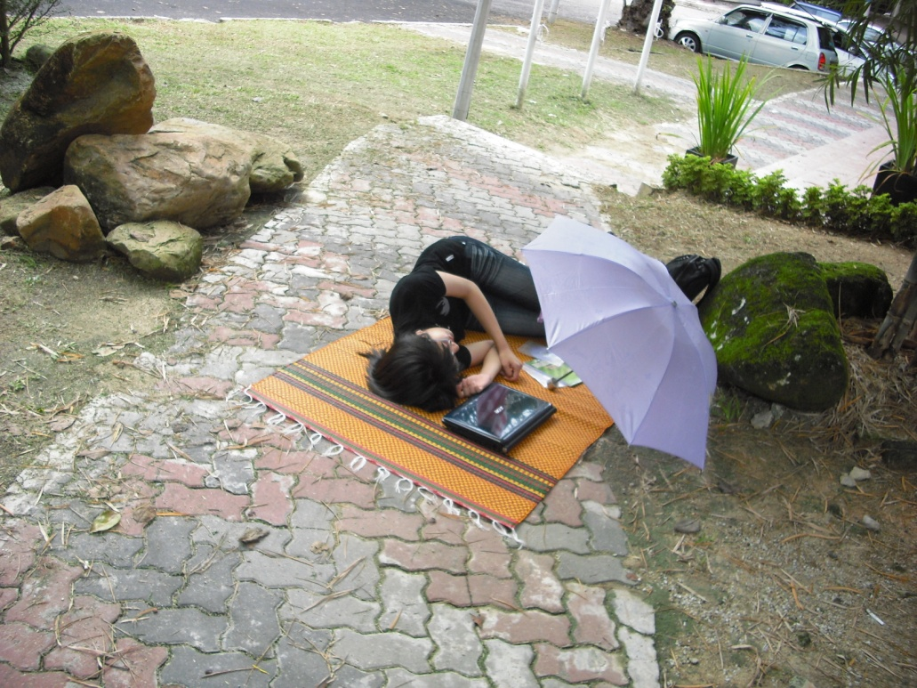
WHAT AM I DOING AT MY SPACE ?
TO LIE ON MY ‘TIKAR’

Slide 11
THE END

